Slide 1
Airline Data Warehouse
Dhanur Sharma
Nahush Bhobe
Aadhar Gautam

Slide 2
Problem Statement
To design a data warehouse for an airline to be able to answer key business questions and provide optimal solutions for pertinent issues.
We will be using 5 dimensions, namely, Time, Ticket, Flight, Agent, and Customer, and arranging it in a star model connected to the Fact table.

Slide 3
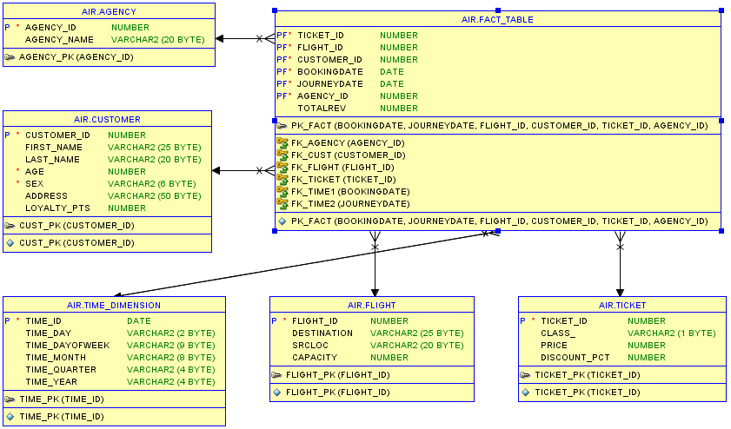
Relational Model

Slide 4
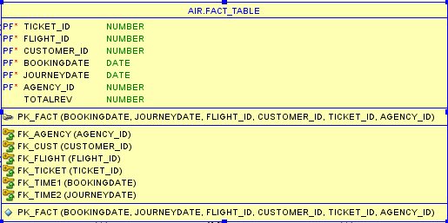
Fact table
Inherits the following Primary keys from the Dimension tables:
flight_id
customer_id
ticket_id
bookingdate
journeydate
agency_id
Measures used:
total_revenue

Slide 5
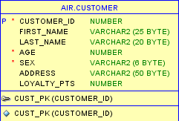
Customer table
Contains the following attributes:
cust_id
first_name
last_name
age
sex
address
loyalty_pts

Slide 6
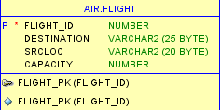
Flight table
Contains the following attributes:
flight_id
destination
srcloc (source)
capacity

Slide 7
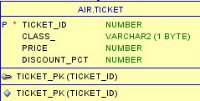
Ticket table
Contains the following attributes:
ticket_id
class_
price
discount_pct

Slide 8
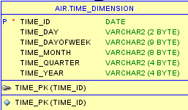
Time table
Contains the following attributes:
time_id
time_day
time_dayofweek
time_month
time_quarter
time_year

Slide 9

Agent table
Contains the following attributes:
agency_id
agent_name

Slide 10
Benefits of using a Data warehouse
The airline industry runs multiple types of operations simultaneously, such as customer service, baggage handling, flight scheduling, ticket sales, and overall business management. As a result, airlines collect and store large amount of heterogeneous data from a wide variety of sources that they can leverage to identify opportunities to improve processes, reduce costs, and increase revenues.
Data warehousing provides a centralized repository for corporate data and information assets. A data warehouse is not identical to the organization’s database used for transaction processing.
This process of centralized data management and retrieval rely on data warehouses, which is defined as a subject-oriented, integrated, time-variant, nonvolatile collection of data in support of management's decision making process.

Slide 11
The company can leverage data mining techniques to improve customers’ loyalty through market segmentation, understand what their competitors are doing, forecast sales, monitor business performance, and detect fraud, waste, and abuse.
It also allows organizations to analyze data from multiple perspectives, categorize it, and uses the information to predict future trends and behaviors, decrease costs, increase revenues, and improve processes.
The architecture is open and scalable and built in such ways that it can support the future expansion of data.

Slide 12
Challenges faced while creating a data warehouse
A key implementation challenge for data warehouses is integrating conflicting or redundant data from different sources. Furthermore, the size of the database and query complexity will affect the type of system needed by organizations.
The implementation of a data warehouse is often a long-term, time-consuming, and resource intensive process. Organizations may not have the necessary expertise to setup and maintain a data warehouse or they may over-estimate the needs of the system, thus leading to higher costs.
Data warehouses capture only a fraction of the information needed by managers for decision-making activities and they often cannot collect, retrieve, and disperse worker’s knowledge.

Slide 13
Challenges in the Airline industry for data warehousing
The airlines industry faces interoperability issues as it uses multiple and complex information technology (IT) systems to support their operations.
Many airlines operate older legacy systems, which can create IT systems integration issues and make it difficult to deploy data warehouses and data mining software.
Multiple mergers and acquisition can also complicate the integration and reconciliation of conflicting or redundant data and can comprise data integrity and security.
Implementing a data warehouse can be costly and cash- strapped airlines may be unable to secure the necessary funding.
Another challenge for airlines as they collect information on passengers is the need to balance the privacy of their customers with the requirements of providing government agencies with the necessary information to support national security efforts.
Airlines must be able to exchange data and information with their multiple business partners, thus complicating further the need for IT systems integration.

Slide 14
Success story in the airline Industry to further endorse the implementation of data warehousing
Continental Airlines (Continental) ranked the lowest among major U.S. Airlines in regards to on-time performance, mishandled baggage, and customer complaints. Historically, Continental had outsourced its operational systems and only received a limited set of scheduled reports and no support for ad hoc queries.Continental decided to develop an enterprise data warehouse, which the CIO identified as “core to Continental strategy and thus should not be outsourced”.The real-time information came from multiple sources including the mainframe reservation system, satellite feeds from airplanes, and a central customer database. The airline leveraged the real-time information to improve the recovery of lost airline reservations, customer value analysis, marketing insight, flight management dashboard, and fraud investigations. Over six years, Continental invested US $30 million in hardware and software that realized over US $500 million in increased revenues and cost savings, and went from “worst to first”.

Slide 15
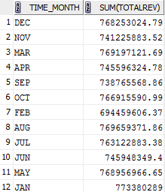
Sample queries

Slide 16
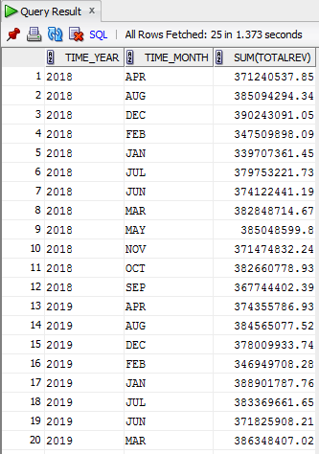
Sample queries

Slide 17
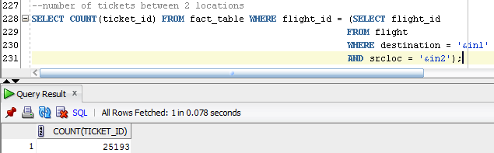
Sample queries

Slide 18
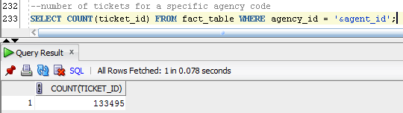
Sample queries

Slide 19
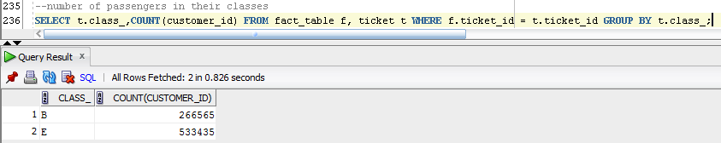
Sample queries

Slide 20
Thank you!

